Slide 1


Employer MyBenefits Portal Tutorial
Reporting A Leave of Absence

Slide 2
Before You Begin
2 of 12
Helpful Tip
Timely reporting of Leave of Absence transactions helps ensure employee eligibility and benefit records remain accurate.
Before reporting a Leave of Absence (LOA), please review the following information:
Report an LOA as soon as it has been approved by your employer.
LOAs can be reported at any time during the year.
If an LOA start date or expected return date changes, update the record as soon as possible.
When an employee returns to work, report the return date promptly.

Slide 3
Before You Begin
3 of 12
You must be logged into the NMPSIA MyBenefits Portal before
completing this tutorial.
If you are a new user, forgot your password, or experience login issues, please refer to the Employer Login Tutorial https://nmpsia.com/employer-trainings.html for complete step-by-step instructions.
Important Reminders
• MFA codes expire after 5 minutes.
• Use the email associated with your NMPSIA benefits.
• Check your Spam or Junk folder if you do not receive your code.
Need help logging in?
Please refer to the Employer Login Tutorial before continuing.
The Employer Login Tutorial includes:
✔ First-Time Login
✔ Password Assistance
✔ MFA Verification
✔ Common Login Errors
✔ Account Assistance
Helpful Tip
Bookmark the Employer Portal login page for quicker access in the future.
Go to NMPSIA.com
↓
Benefits Portal Login
↓
Select Employer
↓
Enter District ID
↓
Select Your Name
↓
Enter Password
↓
Complete MFA Verification

Slide 4
What You'll Need
4 of 12
Before beginning, have the following information available:
District ID
Your login credentials
Access to your authentication email
Employee Social Security Number (SSN)
Approved Leave of Absence start date
Expected return date (if known)
Return-to-work date (when applicable)
Employment status upon return
Helpful Tip
Having the employee's approved LOA documentation available will make the reporting process faster and help reduce errors.

Slide 5
Transaction Overview
5 of 12
Helpful Tip
Every Employer Portal transaction follows the same basic process:
→ Enter → Review → Submit → Verify
Although each transaction may require different information, the overall process remains consistent throughout the Employer Portal.
This tutorial will show you how to:
Report a new Leave of Absence
Update an existing Leave of Absence
Report an employee's return to work
Verify your transaction was submitted successful

Slide 6
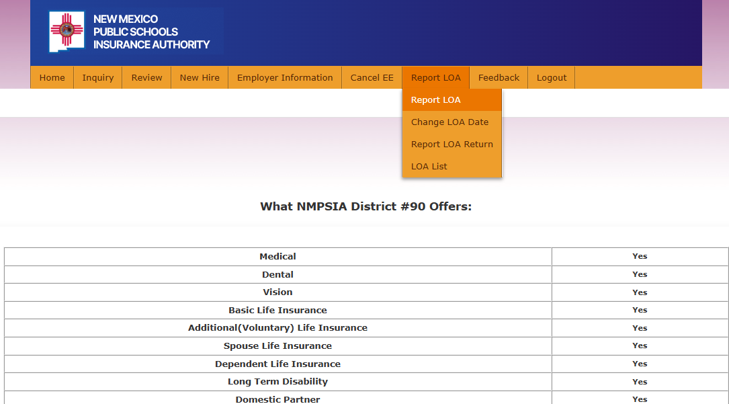
Step 1
6 of 12
From the Home page
Navigate to the Report LOA tab.
Choose one of the following options:
Report LOA
Change LOA Date
Report LOA Return
Helpful Tip
Select only the option that matches the action you are completing. Each option performs a different function.

Slide 7
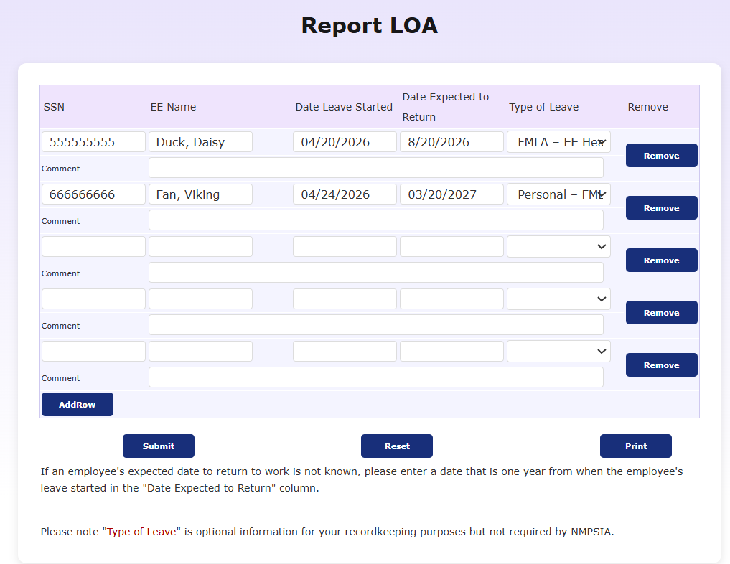
Step 2
7 of 12
Report a NEW LOA
Enter the employee's information.
Verify the employee's name is correct.
Complete all required fields.
Select Submit.
Helpful Tip
Review the Leave of Absence start date carefully before submitting. Accurate dates help ensure employee benefits are administered correctly.

Slide 8
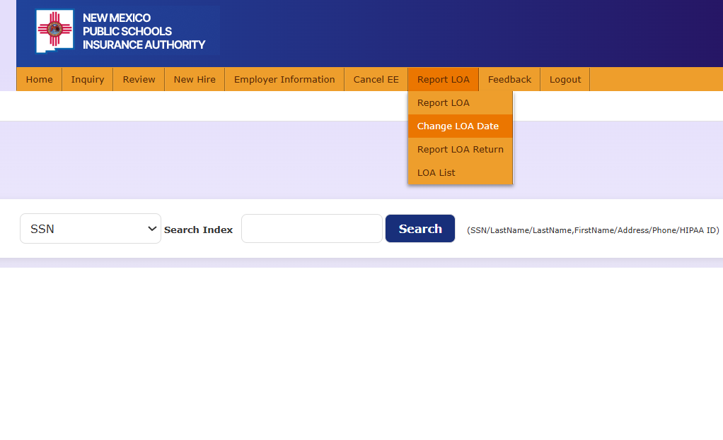
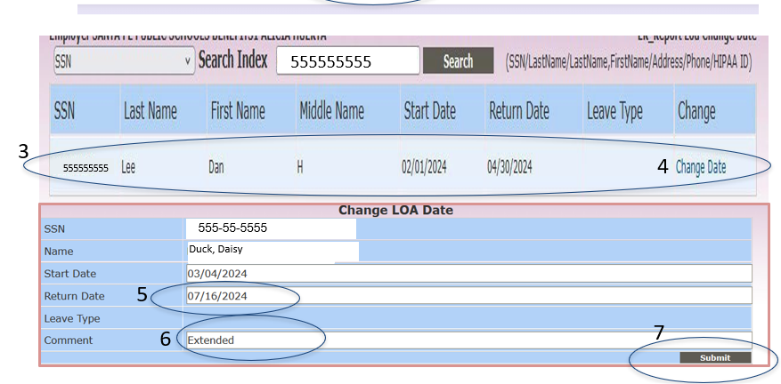
Step 3
8 of 12
Change an LOA Date
If an employee's Leave of Absence dates change:
Select Change LOA Date.
Enter the employee's Social Security Number.
Review the employee information.
Select Change Date.
Update the appropriate date.
Enter a comment describing the reason for the change.
Select Submit.
1
2
Helpful Tip
Provide a clear comment whenever updating an LOA date. This helps document why the change was made.

Slide 9
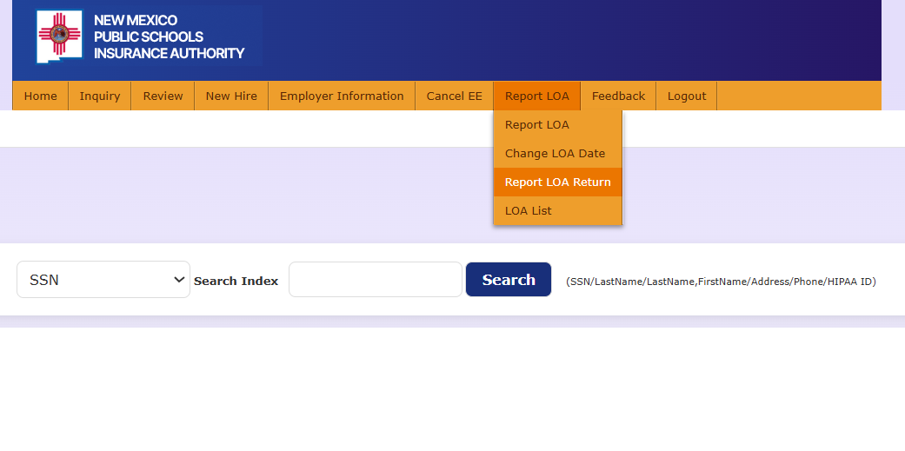
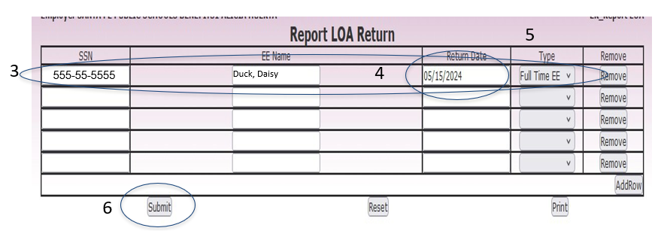
Step 4
9 of 12
When an employee returns from Leave of Absence:
Select Report LOA Return.
Enter the employee's Social Security Number.
Verify the employee information.
Enter the Return-to-Work Date.
Select the employee's employment status upon return.
Select Submit.
1
2
5555555
Helpful Tip
Verify the employees return date and employment status before submitting. This information helps ensure benefits continue correctly.

Slide 10
After Submission
10 of 12
The transaction will be
routed to your EASI Edu
Representative for
final approval.
Updates will be processed
by EASI Edu according
to NMPSIA procedures.
Confirmation of Enrollment is
created and can be found on
Employee account or
Employer account under reports.

Slide 11
Common Errors
11 of 12
Common issues you may encounter
when reporting LOA
Employee not found – Verify the employee's Social Security Number (SSN), Name, or HIPAA ID and search again.
Required fields are incomplete – Complete all required fields before submitting the transaction.
Incorrect Leave of Absence dates – Verify the approved LOA start date, expected return date, or return to work date before submitting.
Incorrect LOA transaction – Select the correct LOA reporting option: Report, Change and Report Return.
Authentication code expired – Request a new Multi-Factor Authentication (MFA) code and sign in again.
Session timed out – Log back into the Employer Portal and restart your request.
Employee information does not match – Verify that you selected the correct employee before submitting the transaction. Review the employee’s name, SSN and other identifying information.
Employment status not selected – Select the employee’s current employment status before submitting the return from leave transaction.
Helpful Tip
If an error continues, contact your EASI Edu Administrative Representative.

Slide 12
Need Assistance
12 of 12
Thank you for supporting your employees!
Contact Us:
EASI Edu
Phone: 1-800-233-3164
Contact your assigned representative for portal assistance.
Or
NMPSIA Benefits Team
Phone: 1-800-548-3724

